Slide 1
Aggregates in SQL
SQL Day 3 class

Slide 2
Learning Objectives
By the end of this lesson, you will be able to:
Calculate the average of a numerical value for a group.
Determine the minimum and maximum numerical value for a group.
Count the number of values and unique values for a field.
Aggregate strings into a delimited list.
Notes:
Speaker Notes:
In this lesson, we'll dive into the powerful world of data aggregation in SQL. Aggregation allows us to summarize and analyze data at a higher level, providing insights into groups of data rather than individual records.
By the end of this session, you will have a solid understanding of how to perform essential aggregation tasks in SQL, such as calculating averages, finding minimum and maximum values, counting data, and aggregating strings.
These skills are fundamental for data analysis and reporting, and they'll empower you to extract meaningful information from your databases. Let's get started!

Slide 3
What is an Aggregate
Aggregates are powerful tools in SQL that transform multiple data points into meaningful and representative statistics.
They enable the consolidation of multiple values from a column or table, resulting in a summarized outcome.
Aggregates are instrumental for summarizing and analyzing data, allowing us to derive insights without having to delve into individual records.
They provide a wide range of statistical information, including central tendencies, totals, extremes, and more, thereby aiding in comprehensive data analysis.
Aggregates can be applied to entire tables or used to analyze data within specific groups within the table.
Notes:
Speaker Notes:
Aggregates in SQL are powerful tools that allow us to summarize and analyze data effectively. They take multiple data points and transform them into meaningful statistics, providing a clearer picture of the data's characteristics.
Instead of dealing with individual records, aggregates help us consolidate and extract valuable insights from our datasets. Whether you need to calculate averages, find totals, identify minimum and maximum values, or even concatenate strings, aggregates offer a versatile set of functions.
One of the key advantages of aggregates is their ability to operate on groups within a table. This means you can analyze subsets of your data, making it particularly useful for comparing different categories or segments and gaining deeper insights into your data. So, let's delve further into these aggregate functions and see how they can unlock valuable insights in SQL.

Slide 4
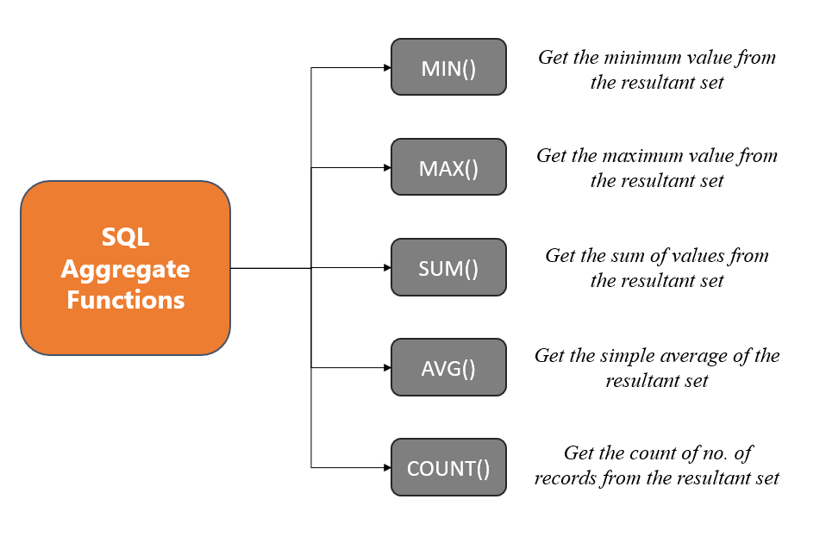
Common Aggregate Functions
Notes:
Speaker Notes:
Now that we understand the importance of aggregates, let's take a look at some common aggregate functions available in SQL. These functions are essential tools for summarizing and analyzing data efficiently.
SUM allows us to add up all the values in a numerical column. It's handy when you want to find the total of a particular attribute, like the total revenue in a sales dataset.
AVG calculates the average of a numerical column, providing insight into the central tendency of the data. For example, you can use it to determine the average rating of products in a customer review dataset.
MIN and MAX help identify the minimum and maximum values in a column, respectively. These functions are valuable for finding extremes within your data.
COUNT is used to count the number of rows in a table or the number of non-null values in a specific column. It's often used for basic statistics or to understand the size of your dataset.
GROUP_CONCAT or STRING_AGG (depending on the SQL dialect) aggregates text values into a delimited list. This function is useful for creating summary reports or joining text values.
In the upcoming sections of this lesson, we'll dive deeper into each of these aggregate functions and explore practical examples to better understand their applications.

Slide 5
Common Aggregate Functions
SUM(): Totals values in a column, useful for running totals, summing money, or aggregating quantities.
Example: SUM(sales) calculates total sales.
AVG(): Calculates the average of values in a column, offering a measure of central tendency.
Example: AVG(test_scores) finds the average test score.
Notes:
[Speaker Note:]
SUM() and AVG() are fundamental tools for handling numerical data. SUM() helps you calculate totals, such as total sales, while AVG() provides a measure of central tendency, like the average test score. These functions are essential for gaining insights and understanding the distribution of your data.

Slide 6
Common Aggregate Functions
MIN(): Locates the minimum value in a column, helpful for determining value ranges and extremes.
Example: MIN(expense) retrieves the lowest expense amount.
MAX(): Identifies the maximum value in a column, aiding in understanding value ranges and extremes.
Example: MAX(revenue) obtains the highest revenue.
Notes:
Speaker Notes:
MIN() and MAX() are handy when you need to pinpoint the smallest or largest values in your data. MIN() helps you find the lowest expense amount, while MAX() helps you identify the highest revenue. These functions are essential for understanding data ranges and extremes, which can be critical for decision-making and analysis.

Slide 7
Common Aggregate Functions
COUNT(): Tallies the number of rows in a column, valuable for counting records, events, and more.
Example: COUNT(customers) calculates the total number of customers.
COUNT(DISTINCT): counts the number of unique values in a column, excluding duplicates.
Example: COUNT(DISTINCT products) gives you the count of distinct product names.
Notes:
[Speaker Note:]
While COUNT() is great for straightforward row counting, COUNT(DISTINCT) takes it a step further by providing the count of unique values in a column.
In the example, COUNT(DISTINCT products) would give you the number of different product names, eliminating duplicates for more precise analysis.
These functions are valuable tools for understanding data volume and uniqueness.

Slide 8
Using Aliases with Aggregates
Aliases: Valuable for renaming columns in aggregate queries, enhancing column name readability.
Syntax:
AGGREGATE_FUNCTION(column) AS alias_name
to create aliases for columns.
Example: In the SQL statement:
SELECT SUM (TotalDue) AS TotalSales,
AVG(LineTotal) AS AverageLineTotal
FROM Sales.SalesOrderHeader;
We use aliases "TotalSales" and "AverageLineTotal" for clarity.
Notes:
Speaker Notes:
When working with aggregate functions in SQL, aliases become an essential tool for simplifying column names and making the output more readable and user-friendly.
The syntax for creating aliases is straightforward: AGGREGATE_FUNCTION(column) AS alias_name. This allows you to assign a custom name to the result of an aggregate function applied to a column.
Let's take a look at an example to illustrate the power of aliases. In the SQL statement provided, we have:
SELECT SUM(TotalDue) AS TotalSales, AVG(LineTotal) AS AverageLineTotal FROM Sales.SalesOrderHeader;
Here, we've used aliases "TotalSales" and "AverageLineTotal" to replace the default column names. This makes it crystal clear that we are calculating the total sales and average line total, improving the understanding of the query's purpose.
As we move forward, we'll explore more scenarios where column aliases can simplify complex queries and help you present your data in a more organized and comprehensible manner.

Slide 9
Using Aliases with Aggregates
Benefits:
Improved Understandability: Results are more easily comprehended with descriptive aliases.
Ease of Reuse: Totals and averages can be reused efficiently.
Analysis and Reporting: Aliases simplify data analysis and reporting tasks.
Best Practice Tips:
Descriptive Aliases: Use names like "TotalSales" and "AveragePrice" for clarity.
Consistency: Maintain consistent alias naming conventions.
Avoid Special Characters: Steer clear of spaces and special characters in aliases.
Notes:
[Speaker Note:]
Utilizing aliases in your aggregate queries brings several advantages. They enhance result understandability, promote ease of reuse, and streamline analysis and reporting tasks. Remember to follow best practices by using descriptive and consistent aliases while avoiding special characters for optimal results.
In summary, using column aliases is a simple yet powerful technique to enhance the readability of your SQL queries and make them more reusable, facilitating both data analysis and reporting tasks.

Slide 10
Using Sum() to Total Values
Functionality:
SUM() is a powerful function designed to aggregate and total all numeric values within a specified column.
It plays a crucial role in calculating financial totals, tracking running totals over time, and summarizing numeric data into comprehensive totals.
Syntax:
To use SUM(), you only need to specify the target column within the parentheses: SUM(column_name)
Examples of SUM() in Practical Scenarios:
Summing Up Sales Figures:
Query: SELECT SUM(sales) AS TotalSales FROM SalesData;
Notes:
[Speaker Note:]
The SUM() function is a versatile tool for adding up numeric values, making it invaluable in various data analysis tasks.
In this example, we use it to calculate the total sales from a dataset named SalesData, and we assign the result an alias TotalSales for clarity.
This function simplifies complex calculations and aids in understanding your data more effectively.

Slide 11
Using Sum() to Total Values
Tips:
Sum Multiple Columns: You can use SUM() to sum multiple columns simultaneously, making it efficient for aggregating complex data.
Use Filters: Apply filters to sum subsets of data, allowing you to obtain specific totals from your dataset.
Limitations:
Numeric Data Only: SUM() works exclusively for numeric data types and won't function with non-numeric data.
Ignores Non-Numeric and NULL Values: It ignores non-numeric values and treats them as zeroes. Additionally, NULL values are excluded from the calculation.
Notes:
[Speaker Note:]
SUM() is a powerful tool for totaling numeric values, but it's essential to be aware of its limitations.
You can leverage its ability to sum multiple columns and apply filters for more precise aggregation.
However, remember that it works only with numeric data types and treats non-numeric values and NULL values differently, which may impact your results.

Slide 12
Using AVG() to Get Averages
AVG() is a versatile function used for computing the average value within a column.
It's ideal for determining central tendencies, mean values, and tracking average metrics over time.
Syntax: The syntax for AVG() is straightforward: AVG(column_name)
Examples of AVG() in Action:
Purpose: To find the average test score of students.
Query: SELECT AVG(test_score) AS AverageScore FROM Students;
Notes:
[Speaker Note:]
AVG() is a valuable tool for calculating central tendencies, such as the average test score in this example.
It simplifies the process of determining mean values and helps you track average metrics over time.
The syntax is straightforward, making it easy to use in your data analysis tasks.

Slide 13
Using AVG() to Get Averages
Tips for AVG():
Average Multiple Columns: You can use AVG() to calculate average values for multiple columns simultaneously, saving time and effort.
Numeric Data: AVG() works with numeric columns only, so ensure your data is properly formatted.
Ignores NULL: It automatically ignores NULL values during calculations, ensuring accurate results.
Limitations:
Sensitive to Outliers: AVG() can be influenced by outliers, so be cautious when interpreting results in the presence of extreme values.
No Data Distribution: It provides the mean value but doesn't show data distribution; consider additional methods for that.
Notes:
[Speaker Note:]
AVG() is a valuable tool for calculating average values, but it's important to be aware of its tips and limitations.
You can make efficient use of it by calculating averages for multiple columns, but remember that it works only with numeric data and ignores NULL values.
However, it can be sensitive to outliers, and it doesn't provide insights into data distribution, which might require additional analysis techniques.

Slide 14
Using MIN(), MAX()
MIN() and MAX() - Finding Extremes:
MIN() and MAX() are essential aggregate functions used to find the minimum and maximum values within a column, respectively.
Syntax: To utilize MIN() or MAX(), specify the target column within the parentheses, like so:
MIN(column_name) or MAX(column_name).
Example:
Purpose: To determine the minimum and maximum product prices in our dataset.
Query: SELECT MIN(ListPrice) AS MinPrice, MAX(ListPrice) AS MaxPrice FROM Production.Product;
Notes:
[Speaker Note:]
MIN() and MAX() are fundamental tools for locating extremes in your data.
They allow you to find the smallest and largest values within a column, making them essential for various data analysis tasks.
In this example, we use them to identify the minimum and maximum product prices in a dataset.

Slide 15
Using MIN(), MAX()
Tips:
Filter by Conditions First: Before applying the MIN() and MAX() aggregate functions, it's often beneficial to filter your data based on specific conditions.
Combine with GROUP BY for Group Counts: You can enhance the utility of MIN() and MAX() functions by combining them with the GROUP BY clause.
Handle Any Data Type: MIN() and MAX() functions are versatile and can be used with columns of various data types, including numeric, date, and more.
Limitations:
MIN()/MAX() Work on Numeric/Date Data: It's essential to note that the MIN() and MAX() functions are primarily designed for numeric and date data types.
Notes:
[Speaker Note:]
While MIN() and MAX() are valuable tools for finding minimum and maximum values, it's important to follow best practices.
Consider filtering data before applying these functions, use them in conjunction with GROUP BY for group-specific calculations, and remember that they work best with numeric and date data types.
Understanding their tips and limitations ensures effective use in your data analysis tasks.

Slide 16
Using Count and COUNT(DISTINCT)
COUNT(): The COUNT() function in SQL is used for counting rows within a dataset.
COUNT(*) :
Counts Rows: COUNT(*) counts the total number of rows in a dataset
including null and duplicate rows.
COUNT(column):
Counts Non-null Values: COUNT(column) focuses on a specific column and counts only rows where that column contains non-null values.
Rows with null values in the specified column are excluded.
COUNT(DISTINCT column):
Counts Unique Values: COUNT(DISTINCT column) counts the total number of unique values within a specific column.
It eliminates duplicates and provides a count of distinct values.
Notes:
[Speaker Note:] COUNT() in SQL offers various ways to count rows based on your specific needs. COUNT(*) counts all rows, including null and duplicates, while COUNT(column) and COUNT(DISTINCT column) provide more targeted counts, focusing on non-null values and distinct values, respectively. Understanding when and how to use these variations is essential for effective data analysis.

Slide 17
Using Count and COUNT(DISTINCT)
Examples:
SELECT COUNT(*) FROM table;
Counts all rows
SELECT COUNT(column1) FROM table;
Counts only non-null column1 rows
SELECT COUNT(DISTINCT (column2) FROM table;;
Tallies all unique values in column2
Notes:
[Speaker Note:]
These examples showcase the flexibility of the COUNT() function in SQL.
The first example counts all rows, while the second one focuses on non-null values in a specific column.
The third example counts the distinct values within another column, eliminating duplicates for a precise count of unique entries.
These variations allow you to tailor your counting based on your data analysis requirements.

Slide 18
Using Count and COUNT(DISTINCT)
Tips:
Use COUNT(*) for Total Rows
COUNT(column) for Non-null Values
COUNT(DISTINCT column) for Uniqueness
Limitations:
Limited to Counting Rows: COUNT() primarily counts rows and doesn't perform calculations on column values.
Ignores NULLs: It excludes rows with null values when using COUNT(column), which may affect the count.
No Arithmetic Operations: COUNT() doesn't support arithmetic operations, such as summing or averaging column values.
Notes:
[Speaker Note:]
Understanding the tips and limitations of the COUNT() function in SQL is crucial for effective data analysis.
Use the appropriate variation based on your needs, and be mindful of its focus on row counts, exclusion of null values, and limited functionality for arithmetic operations.

Slide 19
Using the Group By Clause
GROUP BY groups rows with matching values
It is used with aggregate functions to group calculations
Basic syntax:
SELECT columns, aggregates
FROM table
GROUP BY grouping_column;
Examples:
GROUP BY CustomerID, OrderYear
GROUP BY Region, COUNTRY(Location)
Notes:
[Speaker Note:]
GROUP BY is a critical SQL clause that allows you to group rows with matching values in specified columns.
It is often used in conjunction with aggregate functions to perform calculations on these groups. The basic syntax involves selecting columns and aggregates, followed by the GROUP BY clause specifying the grouping column(s).
This clause is essential for summarizing and analyzing data by different criteria.

Slide 20
Using the Group By Clause
Tips:
Grouping Made Easy: Use GROUP BY to effortlessly group numeric and date columns for analysis.
Clear Aliases: Assign aliases to your groups for clarity and readability.
Single or Multiple Columns: Group by one or more columns based on your analysis requirements.
Sort Groups: Combine GROUP BY with ORDER BY to sort groups for easier analysis.
Limitations:
Non-Grouping Columns: Ensure that you either group by or aggregate any non-grouping columns in the select statement. This can be tricky to get right.
Notes:
[Speaker Note:]
These simple tips for using GROUP BY in SQL can make your data analysis more efficient and comprehensible.
Just remember the limitation regarding non-grouping columns to avoid unexpected outcomes.

Slide 21
Using the HAVING Clause
The HAVING clause filters query results based on aggregate conditions after the GROUP BY operation.
Key Differences from WHERE:
WHERE filters rows before aggregation.
HAVING filters groups after aggregation.
HAVING works on aggregated results.
Basic SQL Syntax:
SELECT group_columns, aggregates
FROM table
GROUP BY grouping_columns
HAVING conditional_check;
Notes:
[Speaker Note:]
The HAVING clause in SQL allows you to filter the results of a query based on aggregate conditions applied after the GROUP BY operation.
It's important to understand the key differences between WHERE and HAVING, as WHERE filters rows before aggregation, while HAVING filters groups after aggregation.
This clause is essential for refining and focusing your grouped results.

Slide 22
Using the HAVING Clause
Example Using HAVING:
SELECT year, SUM(sales) AS total_sales
FROM data
GROUP BY year
HAVING SUM(sales) > 1000000;
Use Cases:
Filter to Significant Groups: Use HAVING to filter and focus on groups with aggregate values meeting specific criteria.
Check for Aggregate Thresholds: Determine if groups meet certain aggregate thresholds before including them in the result.
Focus Analysis on Subset of Data: Use HAVING to refine your analysis by concentrating on a subset of grouped data based on defined conditions.
Notes:
[Speaker Note:]
This SQL example demonstrates how the HAVING clause is used to filter and focus on groups with total sales exceeding 1,000,000 units.
It's a valuable tool for narrowing down your analysis to specific subsets of data based on aggregate conditions.

Slide 23
Using the HAVING Clause
Tips:
Aggregate Focus: Use HAVING to filter and focus on groups with specific aggregate characteristics.
Threshold Check: Check for aggregate thresholds to include or exclude groups in your results.
Refine Analysis: Utilize HAVING to refine your data analysis by concentrating on a subset of grouped data based on defined conditions.
Limitations:
Post-Aggregation: HAVING operates on aggregated results, so it can't filter individual rows.
Aggregate-Specific: It's designed for aggregate operations and doesn't filter individual rows based on non-aggregate conditions.
Notes:
[Speaker Note:]
The HAVING clause is a valuable SQL tool for filtering and refining grouped data based on aggregate conditions.
However, it has some limitations, such as operating on aggregated results and potential performance considerations when dealing with complex conditions.
Understanding these tips and limitations will help you use HAVING effectively in your data analysis.

Slide 24
Summary
Aggregates:
Aggregates perform calculations across rows of data to produce summarized results.
GROUP BY:
GROUP BY categorizes rows into groups to apply aggregates per group. This segments the data to show aggregates by categories.
HAVING:
HAVING enables filtering group results by aggregate criteria to focus on significant groups. It is the aggregation equivalent of WHERE.
In Summary:
Together, aggregates along with GROUP BY, HAVING, and ORDER BY provide the ability to summarize, analyze, and understand SQL data at a higher level.
Notes:
[Speaker Note:]
Aggregates, GROUP BY, HAVING, and ORDER BY are powerful SQL components that work in tandem to help you gain deeper insights into your data.
They allow you to perform calculations, segment data into meaningful groups, filter group results, and order your results for comprehensive data analysis and understanding.

Slide 25
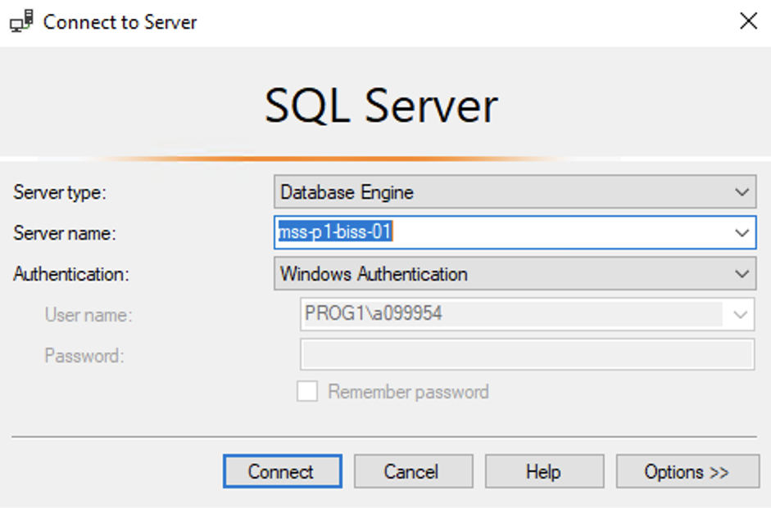
Hands On Examples
Using the AdventureWorks2012 Database
Please open up SSMS
Connect to BISS
Server = mss-p1-biss-01

Slide 26

Hands On Examples
Click File -> Open -> File

Slide 27
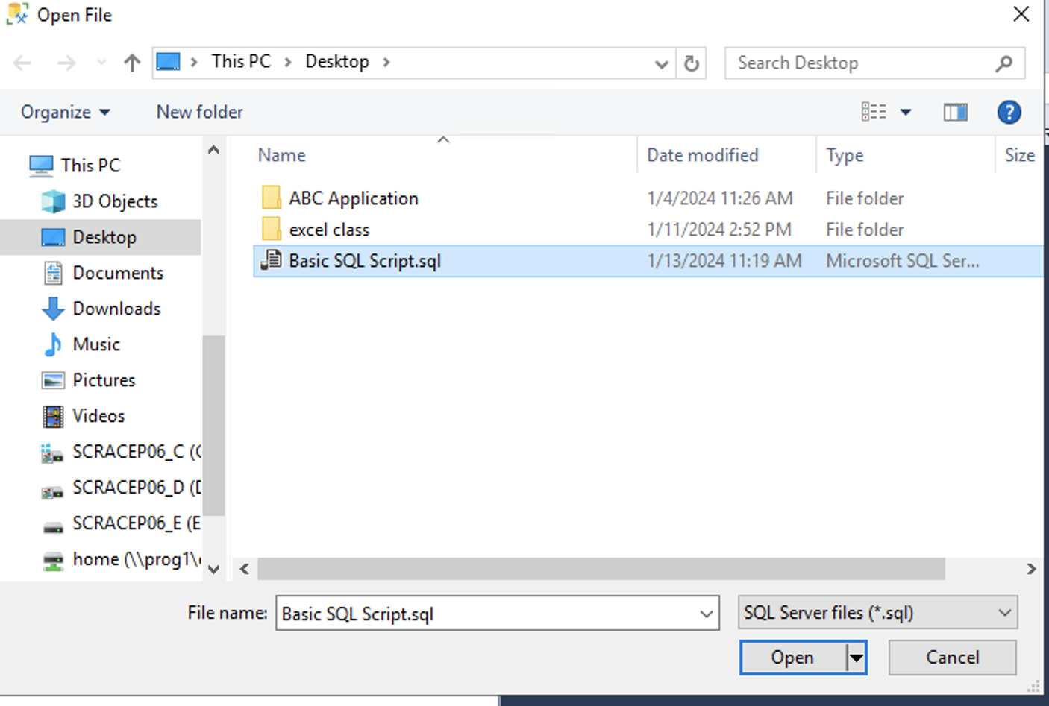
Hands On Examples
Open the SQL Day 3 Aggregates Guided Script.sql file
Notes:
Walk through each function

Slide 28
Exercise
Open the Day 3 Exercise.sql file
Answer the questions from each section
Notes:
Answers are stored in the Exercise Answers.sql file

